Slide 1
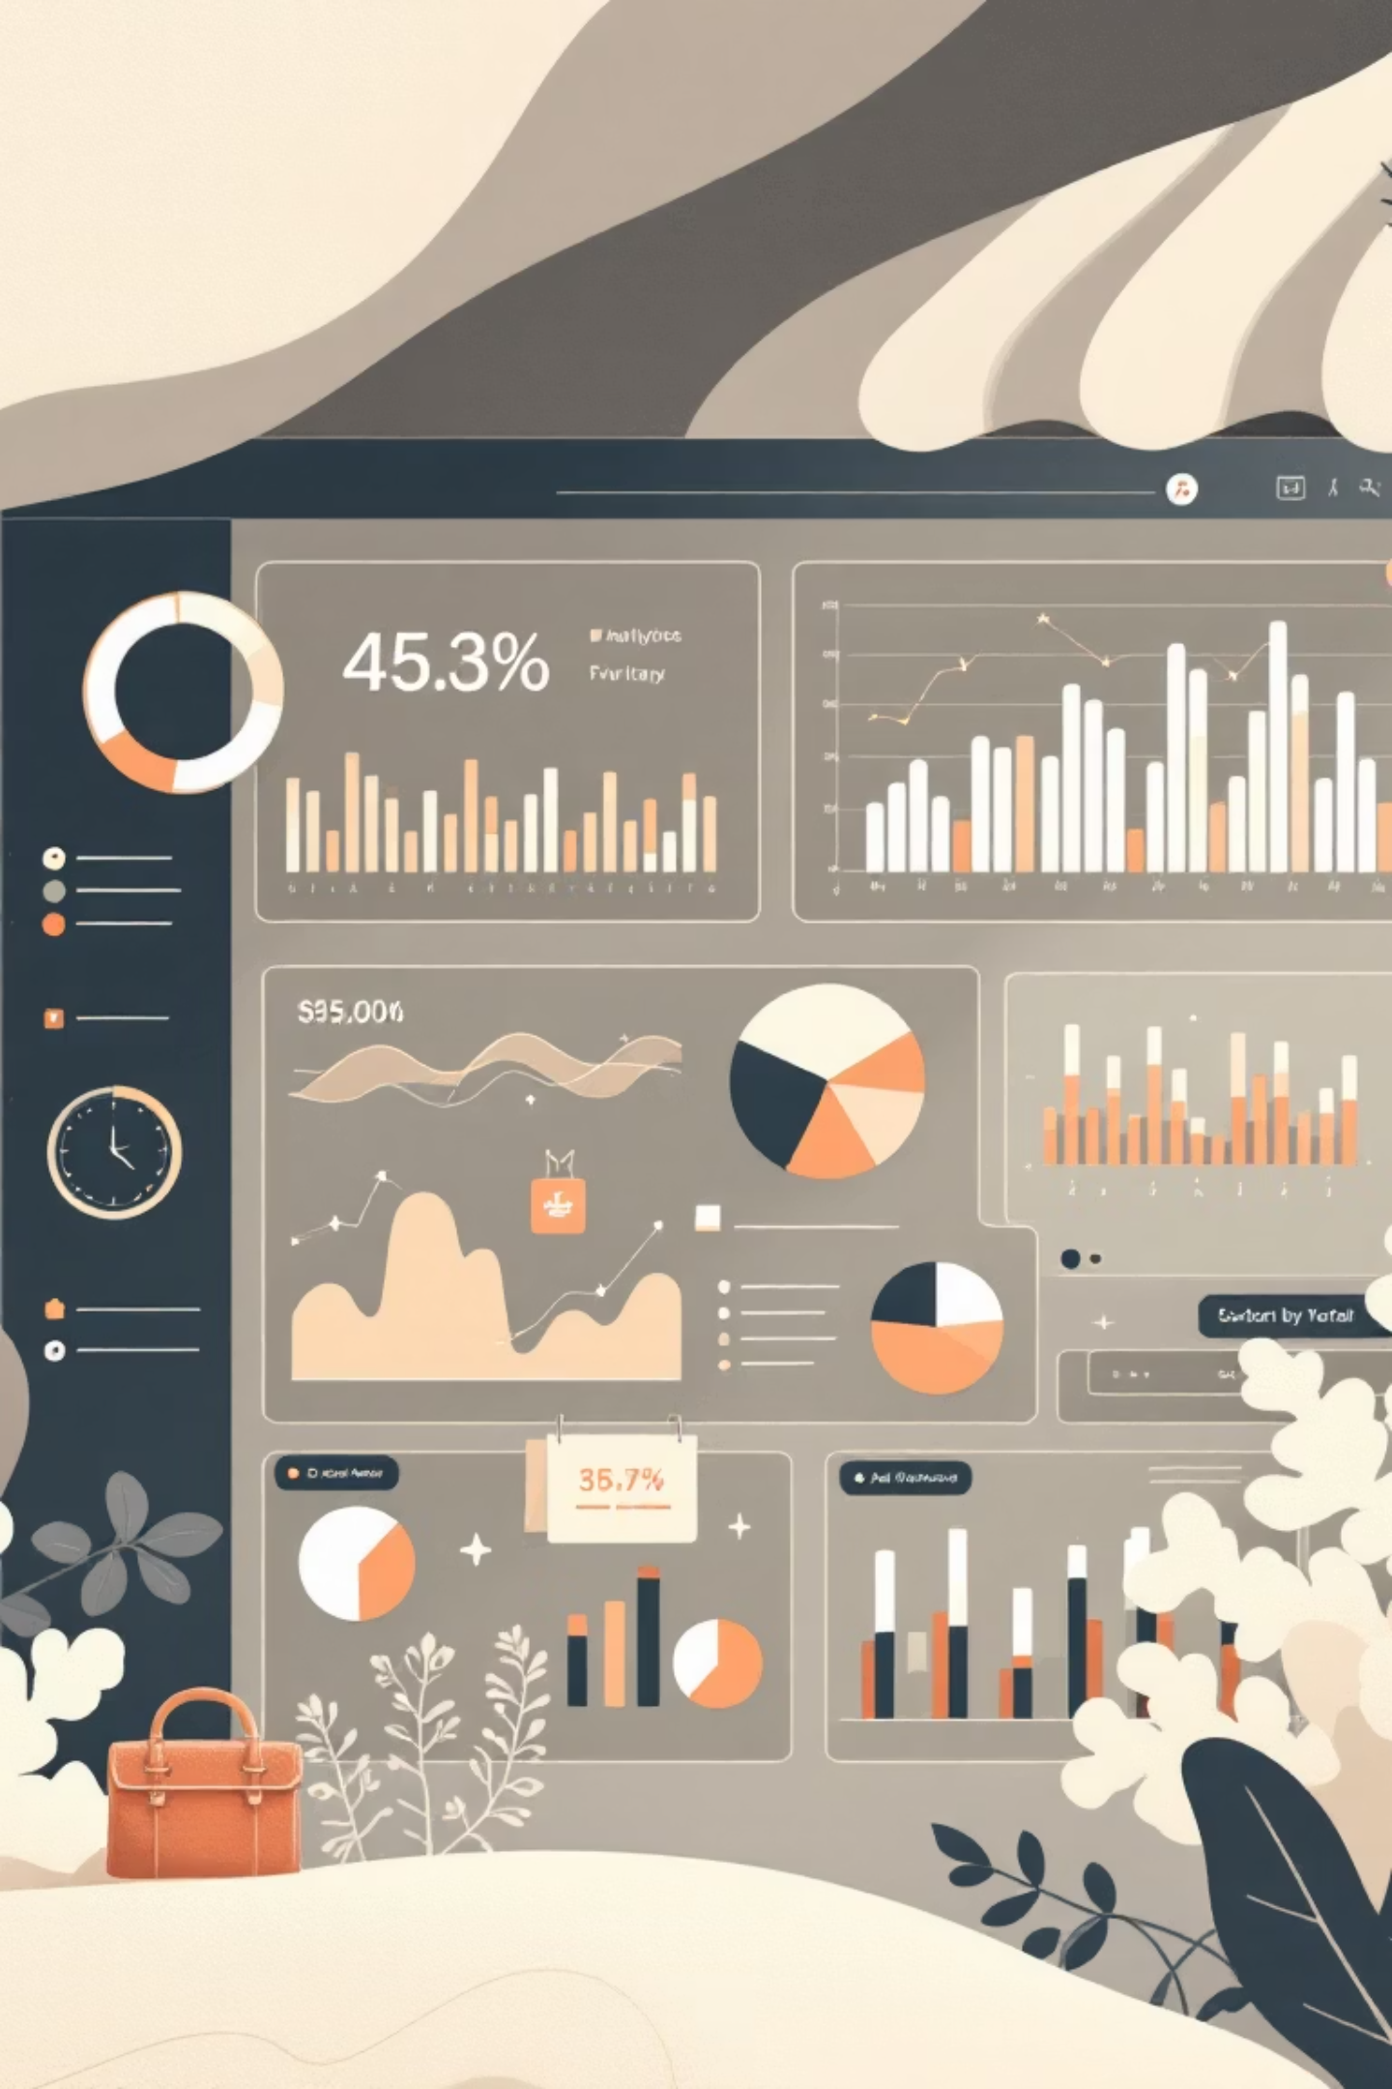
Customer Shopping Behavior Analysis
Analyzing 3,900 customer transactions to uncover spending patterns, preferences, and strategic opportunities for business growth.

Slide 2
DATASET OVERVIEW
Understanding Our Data Foundation
3,900
18
50
25
Total Purchases
Data Points
Locations
Product Types
Transactions analyzed across all categories
Features tracking customer behavior
Geographic distribution of customers
Diverse items across four categories
Dataset includes customer demographics, purchase details, shopping behavior patterns, and review ratings with minimal missing data (37 values in Review Rating).

Slide 3


PYTHON ANALYSIS
Data Preparation & Engineering
01
Data Loading & Exploration
Imported dataset using pandas, examined structure with df.info() and summary statistics
02
Cleaning & Standardization
Imputed missing Review Ratings using median by category, standardized columns to snake case
03
Feature Engineering
Created age_group bins and purchase_frequency_days columns for deeper analysis
04
Database Integration
Connected to PostgreSQL and loaded cleaned data for SQL business analysis

Slide 4
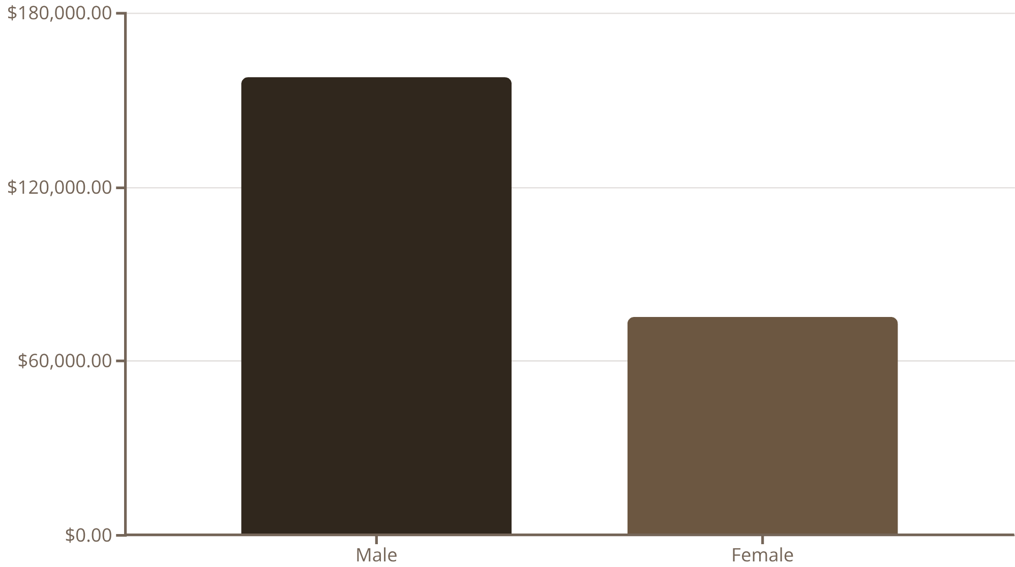
SQL INSIGHTS
Revenue Analysis by Gender
Male Customers Drive Revenue
Male customers generate $157,890 in total revenue, more than double female customers at $75,191.
This represents a significant opportunity for targeted marketing strategies.

Slide 5
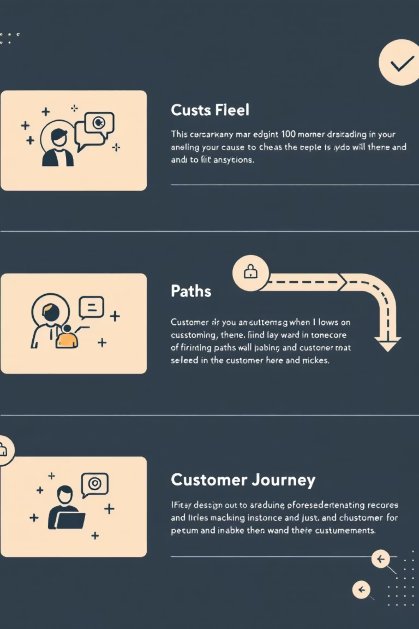
Customer Segmentation Insights
Loyal Customers
Returning Customers
3,116 customers
701 customers
The largest segment showing consistent purchase behavior and brand commitment
Engaged buyers with growth potential for loyalty program conversion
New Customers
83 customers
Fresh acquisition opportunities requiring nurturing strategies
Customers with more than 5 purchases show strong subscription potential, with 958 repeat buyers already subscribed versus 2,518 non-subscribers.

Slide 6
PRODUCT PERFORMANCE
Top-Rated Products & Categories
Highest Rated Items
Category Leaders
Gloves - 3.86 rating
Clothing: Blouse (171 orders), Pants (171), Shirt (169)
Accessories: Jewelry (171), Sunglasses (161), Belt (161)
Sandals - 3.84 rating
Footwear: Sandals (160), Shoes (150), Sneakers (145)
Outerwear: Jacket (163), Coat (161)
Boots - 3.82 rating
Hat - 3.80 rating
Skirt - 3.78 rating

Slide 7




Discount Strategy Analysis
50%
49.7%
Hats
Sneakers
Highest discount rate
Second most discounted
49.1%
48.2%
Coats
Sweaters
Heavy discount dependency
Frequent promotions
Smart Spenders
Shipping Insights
839 customers used discounts but still spent above the $59.76 average purchase amount, ranging from $62 to $97 per transaction.
Express shipping customers spend $60.48 on average versus $58.46 for standard shipping.

Slide 8
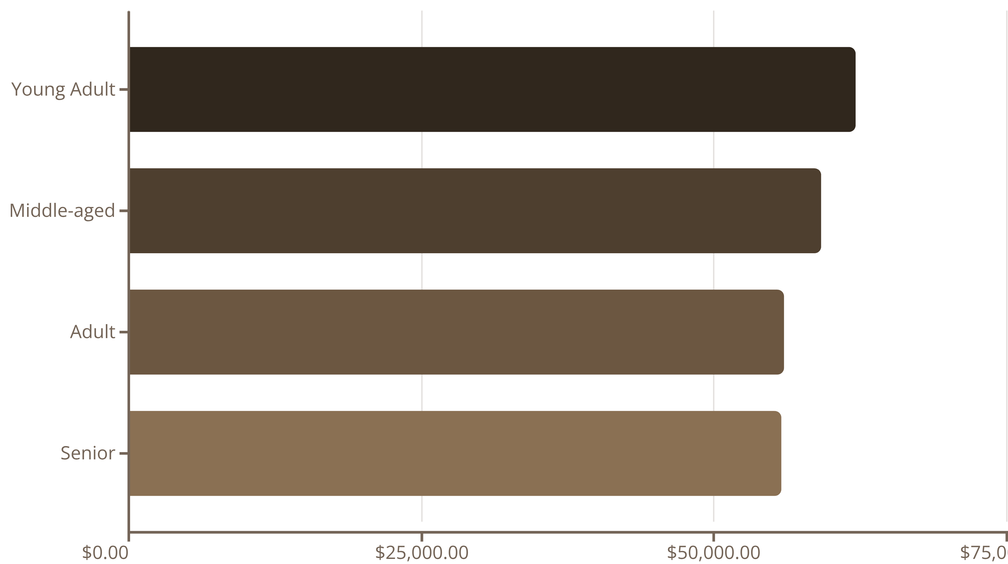
DEMOGRAPHICS
Revenue by Age Group
Young adults lead revenue generation at $62,143, followed closely by middle-aged customers. Distribution is relatively balanced across all age groups, suggesting broad market appeal.

Slide 9

POWER BI
Interactive Dashboard Overview
Key Metrics
Subscription Split
Dynamic Filters
3.9K customers tracked
27% subscribed customers versus 73% non-subscribers
Analyze by subscription status, gender, category, and shipping type for deep insights
$59.76 average purchase
3.75 average rating

Slide 10





STRATEGY
Business Recommendations
Boost Subscriptions
Promote exclusive benefits to convert the 73% non-subscriber base, especially among repeat buyers
Customer Loyalty Programs
Reward the 701 returning customers to accelerate their transition into the loyal segment
Review Discount Policy
Balance promotional sales boosts with margin control, especially for high-discount products
Targeted Marketing
Focus campaigns on young adults, express-shipping users, and top-rated products like gloves and sandals

